Slide 1

MemFlash
Faster access to your data
Gunjan Patel

Slide 2


Whaaaaaaaat?!

Slide 3


Motivation
Memory stores are fast but no persistence
DBs persist the data, but don’t manage their own memory (not as fast)
Wall Street people pay Millions of $$s for transactions faster even by a few microseconds

Slide 4


MongoDB v/s Memcache
MongoDB is a NoSQL DB
Persistent
Speed is HDD bound
Loads some data in memory
Doesn’t manage it’s own memory
Memcache is a in-memory key-value store
Non-persistent
As fast as RAM
Everything is in memory
Manages it’s own memory

Slide 5




Technology Stack
Go Programming language <3
Docker containers
StatsD/Graphite
Memcache
MongoDB
Docker Compose
Alpine Linux

Slide 6
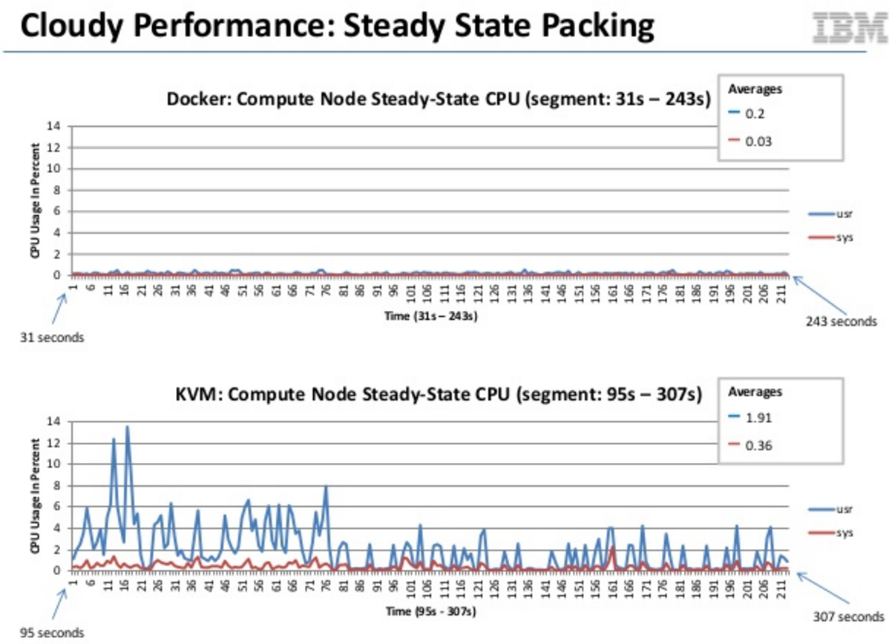
Why Docker and not VM?

Slide 7
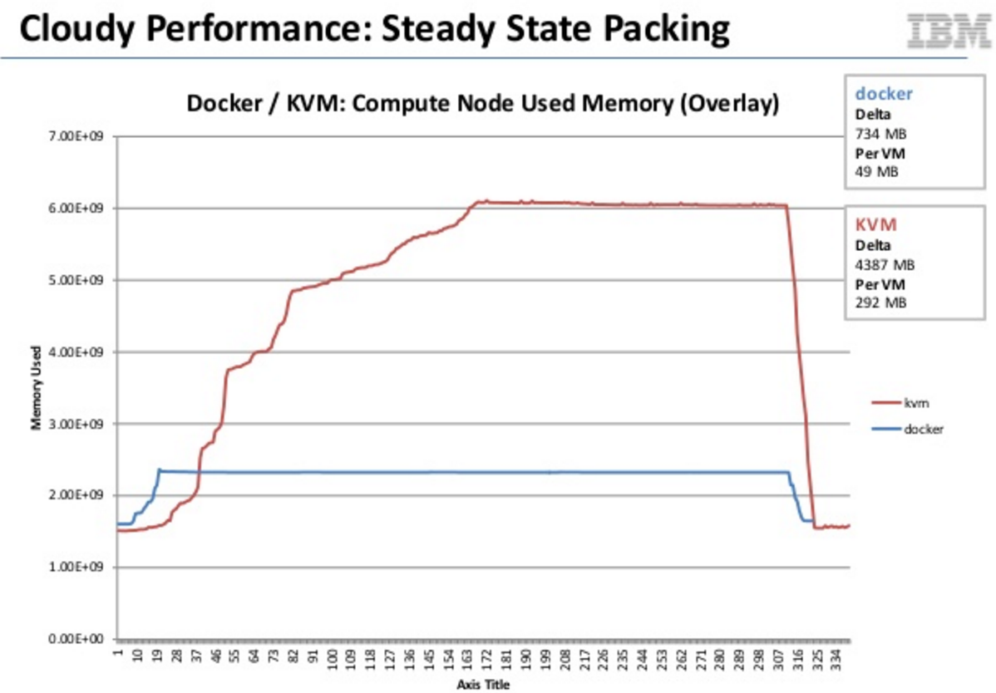
Why Docker and not VM?

Slide 8
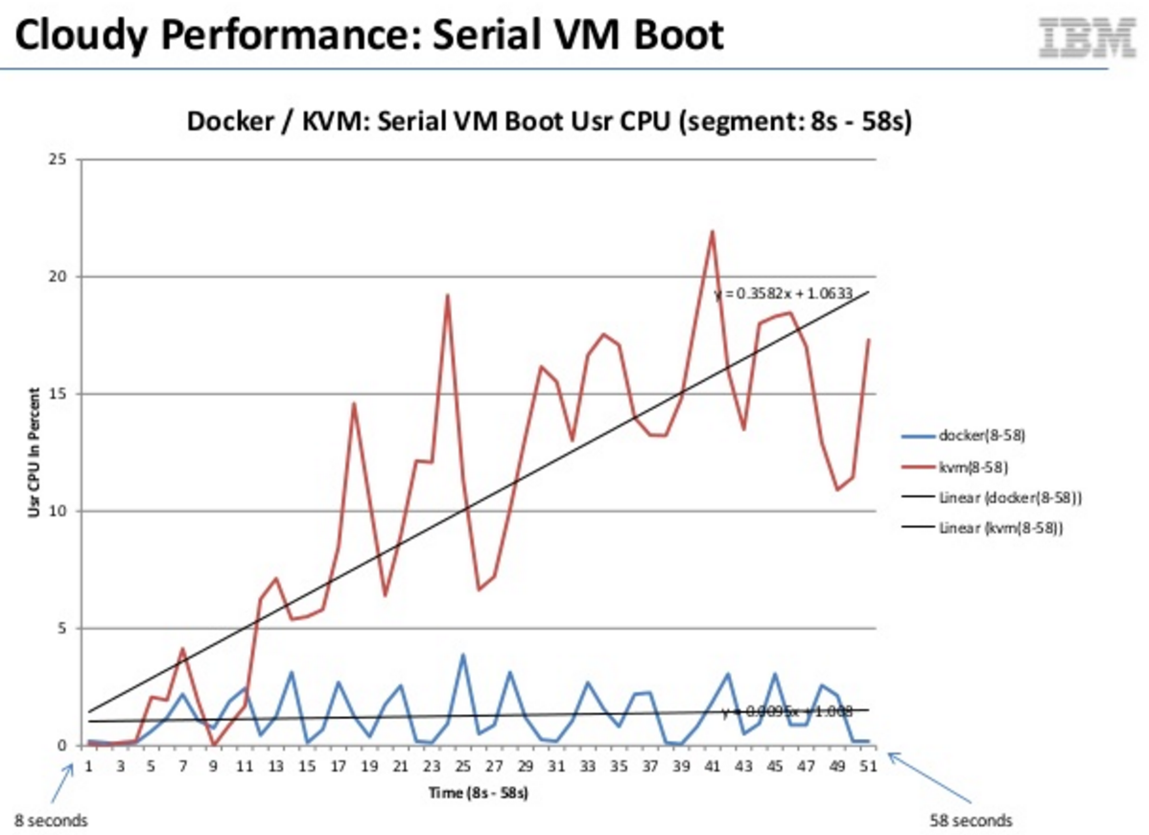
Why Docker and not VM?

Slide 9
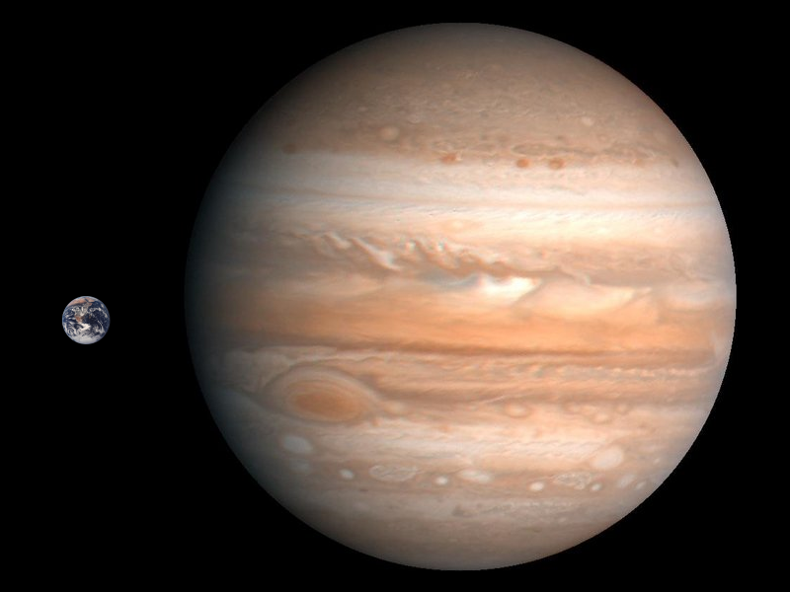
Why Docker and not VM?

Slide 10
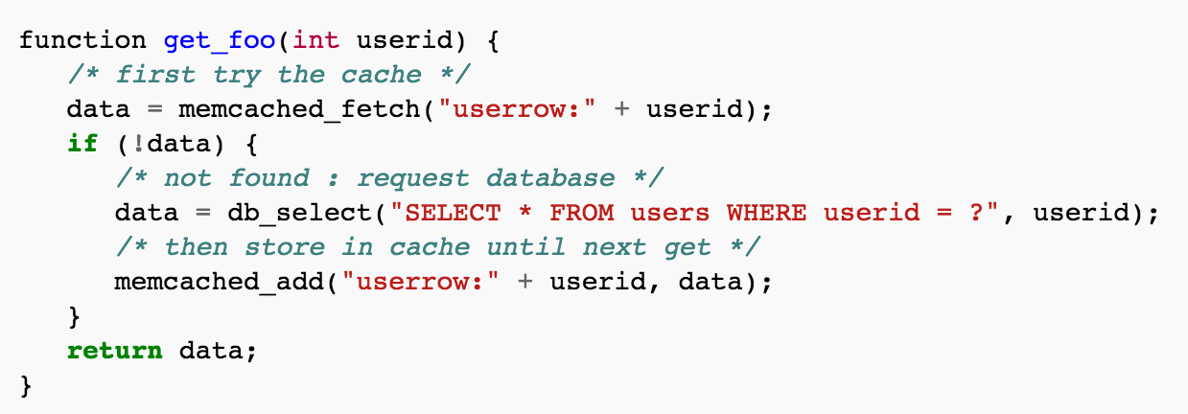
Approach

Slide 11

Approach…
Server
MISS
Cache
Database

Slide 12
Priority system
P1
2 threads, one to Memcache another to MongoDB (whichever comes first)
If miss => store the data in Memcache
P2
First check Memcache, if miss => check MongoDB
If miss => store the data in Memcache
P3
Only MongoDB

Slide 13

Approach 2.0
Profit $_$
Server
MISS
Cache Thread
Cache
DB Thread
Database
Database

Slide 14
Demo Setup
10,000 JSON objects
All 10,000 objects in MongoDB
50% of the objects are also in Memcache
50% Hit/Miss ration
MongoDB, Memcache, StatsD server running in 3 different Docker containers
One program inserts the JSON objects
3 demo scripts pull the data with Priority 1, 2 & 3

Slide 15


Slide 16
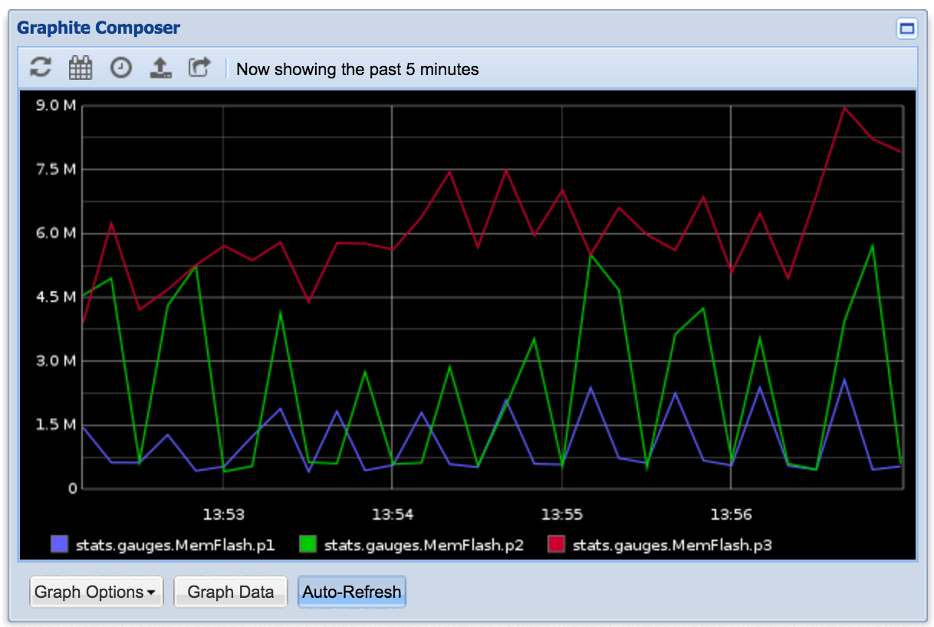
In case if demo didn’t go well…

Slide 17
Challenges
Combining Memcache + MondoDB is hard ☹
A lot of concurrency issues
Not much documentation for Go libraries
Had to read library source code

Slide 18




Future work
Add support for Redis
Add Memcache Proxy (to reduce # of TCP connections)
Cloud providers charge money for number of connections
Use gRPC for transferring JSON-like data
HTTP/2, header compression, binary JSON (bson)
Kubernetes replication (Mem usage)

Slide 19


Thank you!
https://github.com/gunjan5/memflash

